Slide 1



EXCHANGE UNION

Slide 2
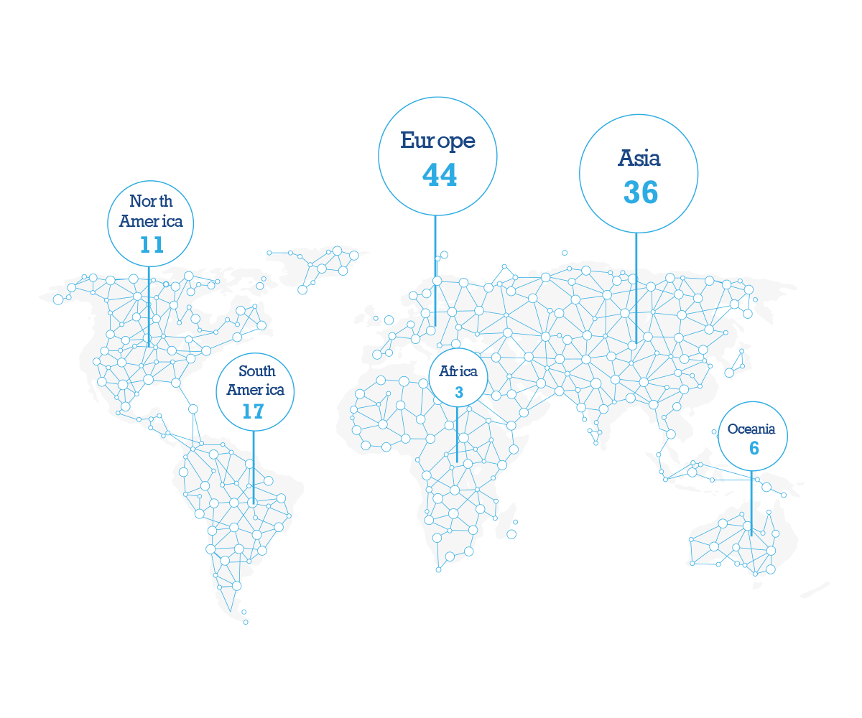
数字资产市场
全球数字资产种类：
1,500+
数字资产市场资本总额：
$4000亿+
24小时交易额:
$170亿+
数字资产交易所数量:
100+
Number of Digital Asset Exchanges per Continent
As of March 1st 2018

Slide 3

行业痛点
交易所：
业务本地化，且交易所间互相分隔独立
交易品种有限
难以维持高流动性
投资者：
各交易所之间价差大
跨交易所交易效率低且费用高
需要在不同的交易所开通并验证账号
Notes:
Why we started Exchange Union – Industry Pain Points

Slide 4


Exchange Union愿景
“全球首家实现数字资产交易所间，即时且无需信用背书的去中心化交易网络。”
Notes:
READ

Slide 5

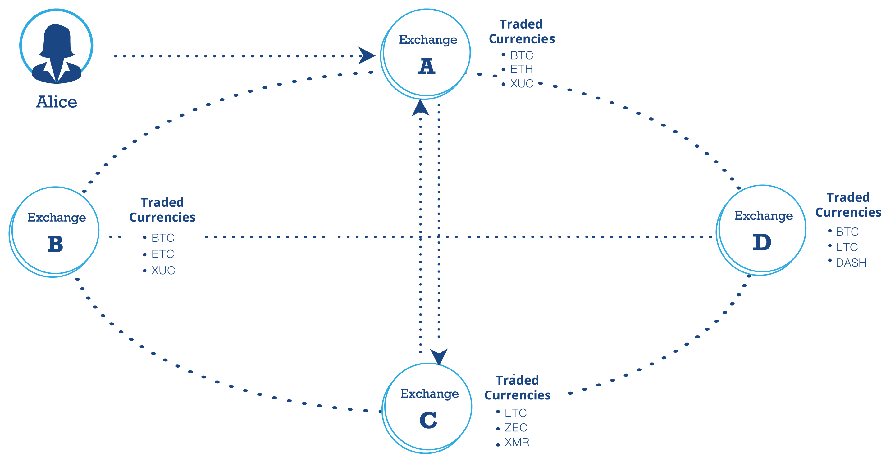
Exchange Union方案概览
Notes:
We have exchanges, all connected through the exchange union network
With users on these exchanges

Slide 6
Exchange Union方案概览
Orderbook
SELL
ExchB: 100 ZEC for 20 BTC
BUY
ExchA: 10 LTC for 20 ETC
Orderbook
SELL
ExchB: 100 ZEC for 20 BTC
BUY
ExchA: 10 LTC for 20 ETC
Orderbook
SELL
ExchB: 100 ZEC for 20 BTC
BUY
ExchA: 10 LTC for 20 ETC
Orderbook
SELL
ExchB: 100 ZEC for 20 BTC
BUY
ExchA: 10 LTC for 20 ETC
Orderbook
SELL
ExchB: 100 ZEC for 20 BTC
BUY
ExchA: 10 LTC for 20 ETC
Orderbook
SELL
ExchB: 100 ZEC for 20 BTC
BUY
ExchA: 10 LTC for 20 ETC
Notes:
Exchanges exchange their orderbooks through exchange union
Everyone knows about all orders

Slide 7
Exchange Union方案概览
10 LTC
10 ETH
1 BTC
20 ETC
Notes:
And now their users can directly trade with each other
Without leaving their exchange

Slide 8

受益群体
交易所：
更大的用户基数
增加交易量及营收
增加交易流动性
健壮的去中心化交易架构
用户:
缩小交易档差
获得最好的价格
开放全部的交易对
不需要开通验证多个账号
Notes:
Exchanges
Increased earnings by allowing Exchange A & B to keep full maker taker fee EACH
Double the earnings so to speak
Worst case: all trades go via XU, no trade comes in -> earnings stay the same. No difference if locally or via XU
Users
increased liquidity through combined orderbook of all exchanges in the union
Best price win-win: for user trade only happens if the price is cheaper

Slide 9

开发团队任务
建立一个连接各交易所的方案：XU Node
是否开源？是的！
目前我们最主要的任务：建立开发者社群
Bitcoin → 开源开发的新时代
我们相信开源项目是能够自我维系的
开源方式提升项目的价值
开源方式使得项目的激励机制更有价值
开源共享方式可以让开发者自由地加入项目并获得开发回报
Notes:
Open Source:
We are using a lot of open-source software, like lightning, bitcoin, ethereum
Tech new & complex: Peer review & testing necessary
Exchange Union is infrastructure
Open Source the best way to do it

Slide 10
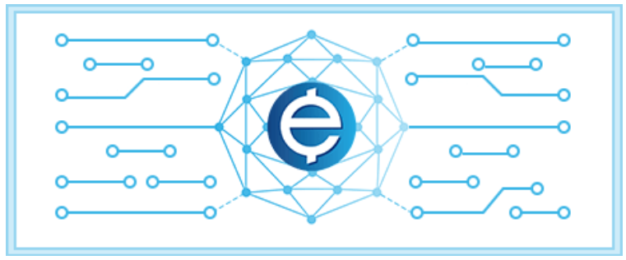
运营机制
XUC
联盟中的激励机制
Notes:
XUC as reward and fee system to
a) Get XU up and running
b) Keep it running
In short: Rewards for providing services, fees for using them

Slide 11
服务提供激励
XUC 将奖励以下服务提供者
提供交易流动性 / 做市商
验证委托订单
提供支付通道服务
Notes:
On the other hand that means XUC will be used to pay for
Relay & validate orderbooks, like we saw before
Other services like watchtower; specific to payment channels

Slide 12
服务提供激励
XUC 将奖励以下参与者
交易所：加入交易所联盟，提供流动性
交易者：通过Exchange Union完成一定量的交易
开发者：对Exchange Union的开发做出贡献：代码被采用、代码审核、执行测试
Notes:
On the other hand that means XUC will be used to pay for
Relay & validate orderbooks, like we saw before
Other services like watchtower; specific to payment channels

Slide 13
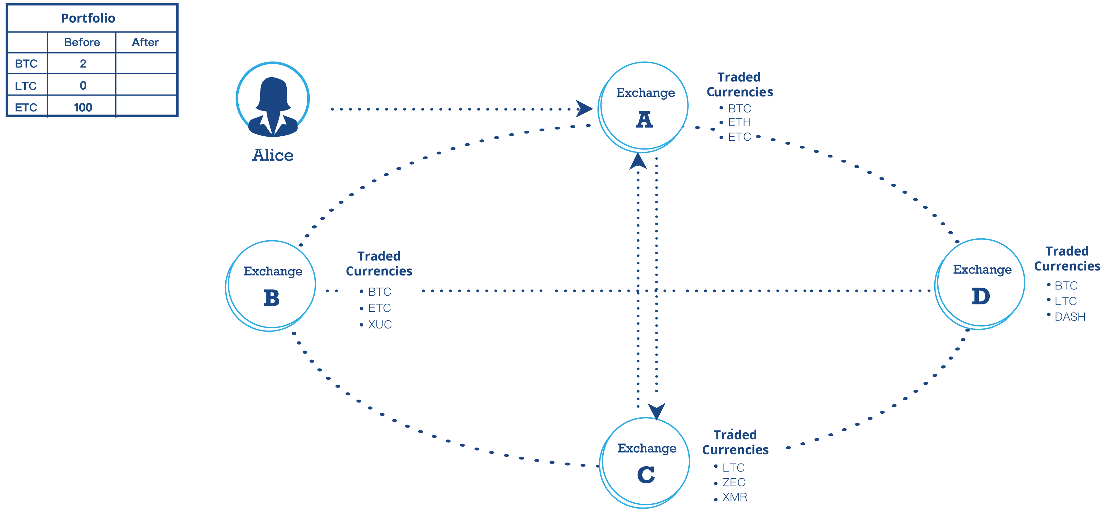
应用案例
Notes:
How does that look in practice?

Slide 14
应用案例
10 LTC
Notes:
How does that look in practice?

Slide 15
应用案例
Market Order: BUY 10 LTC using ETC

Slide 16
应用案例
Find best price within Exchange Union

Slide 17
应用案例
10 LTC = 20 ETC
Bob

Slide 18
应用案例
10 LTC
20 ETC
Bob
Notes:
ExchA transfers (real!) 20 ETC to ExchC

Slide 19

应用案例
Bob
Notes:
- Wallets on Exchange A & C get updated
Alice can see her Litecoin in her portfolio
Now: How do we realized this technically?
Especially that A & C don’t have to trust each other
Allow any exchange to join XU

Slide 20
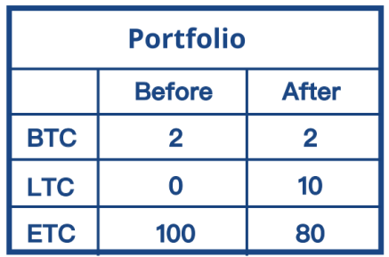
应用案例
Bob
Notes:
- Wallets on Exchange A & C get updated
Alice can see her Litecoin in her portfolio
Now: How do we do this technically?
So that A & C don’t have to trust each other

Slide 21
技术架构
三项核心技术

Slide 22

技术架构
1. 支付通道
每笔交易将通过支付通道实现交易所间真实的即时数字资产转移
三项核心技术

Slide 23

技术架构
1. 支付通道
每笔交易将通过支付通道实现交易所间真实的即时数字资产转移
三项核心技术
2. 原子互换
原子互换保证两个交易所间可以实施无需信用背书的交易

Slide 24

技术架构
1. 支付通道
每笔交易将通过支付通道实现交易所间真实的即时数字资产转移
三项核心技术
2. 原子互换
原子互换保证两个交易所间可以实施无需信用背书的交易
3. 去中心化委托簿
解决数字资产交易所如何有效连接买卖双方的问题
Notes:
Now introduce these 3 each

Slide 25
1. 支付通道
我们提到的支付通道正是闪电网络和雷电网络！

Slide 26



1. 支付通道
A&B
Exchange A
Exchange B
Special Wallet
Notes:
First high-level

Slide 27

1. 支付通道
A&B
Exchange A
Exchange B
Special Wallet
Deposit: 100 LTC
Deposit:
0 LTC

Slide 28


1. 支付通道
A&B
A
A&B
B
B
Exchange A
Exchange B
Special Wallet
A
100 LTC
0 LTC
Payment Channel

Slide 29

1. 支付通道
A
B
B
Exchange A
Exchange B
A
100 LTC
0 LTC
Payment Channel

Slide 30
1. 支付通道
A
B
B
Exchange A
Exchange B
A
99 LTC
1 LTC
Payment Channel

Slide 31
1. 支付通道
Layer 2
支付通道
建立在底层公链之上
从公链上继承了所有的安全属性
A
B
B
Exchange A
Exchange B
A
99 LTC
1 LTC
Payment Channel
Layer 1
底层公链
Notes:
Layer 2 = off-chain
This is how it can be instant
We are not building another blockchain

Slide 32
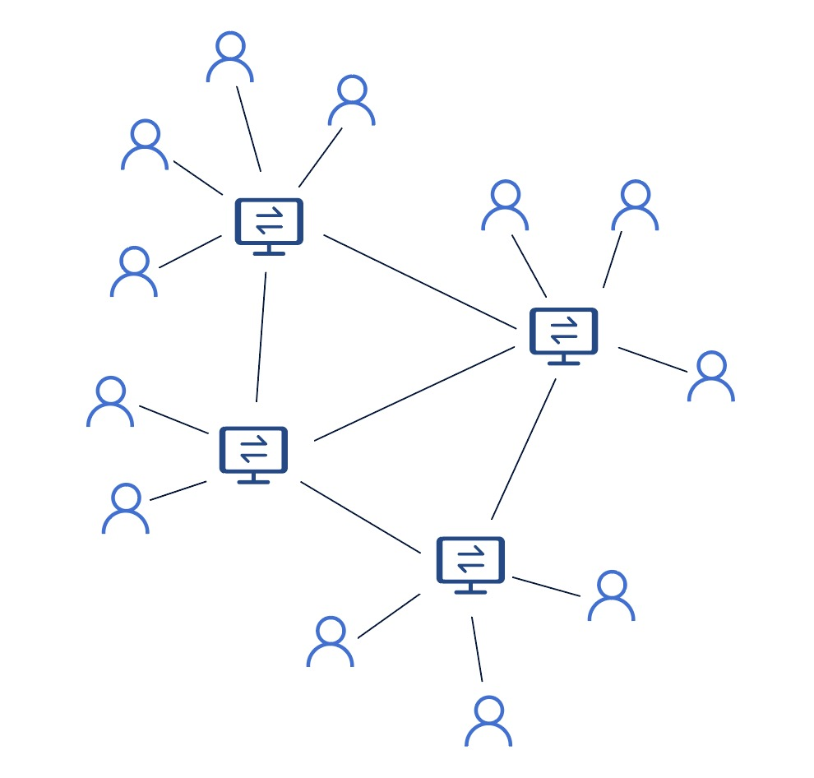
1. 支付通道
路由:
A
D
B
C
Notes:
Beauty: Payment channels support routing

Slide 33
1. 支付通道
路由:
A
D
B
C
Notes:
Like data packets on the internet!

Slide 34
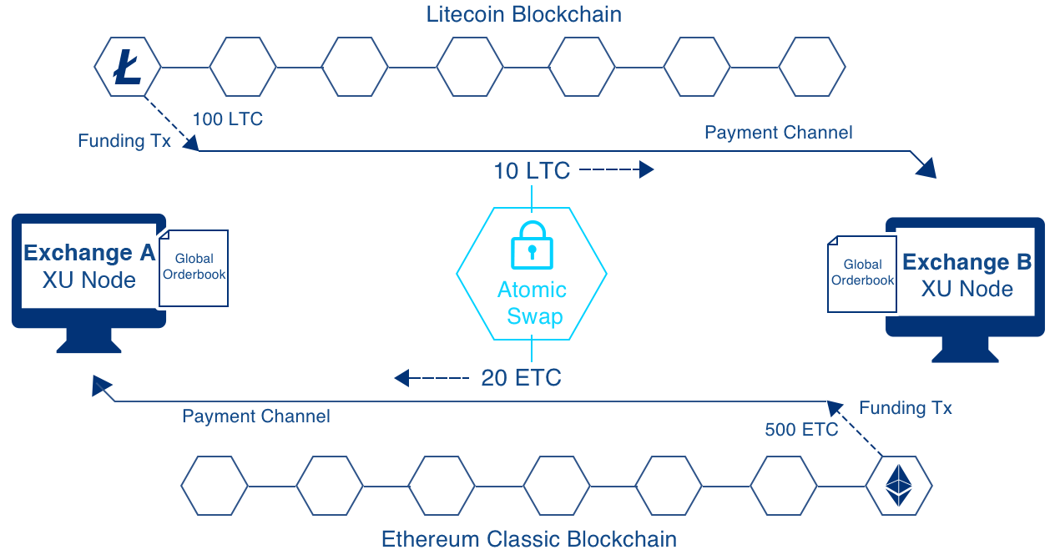

1. 支付通道
Bob
Notes:
Big picture like this
One crucial element missing: How to ensure B just doesn’t run away after receiving 10 LTC?

Slide 35
2. 原子互换
Bob

Slide 36

2. 原子互换
对于两种不同资产无需信用背书的交易
无需中间人及第三方保障服务
如何实现：通过原子性的保证
交易双方的两笔转账要么同时发生，要么都不发生
技术：Hashed TimeLock Contracts (HTLCs)

Slide 37
3. 去中心化委托簿
Orderbook
SELL
-
BUY
ExchA: 10 LTC for 20 ETC
Orderbook
SELL
-
BUY
ExchA: 10 LTC for 20 ETC
Orderbook
SELL
-
BUY
ExchA: 10 LTC for 20 ETC
Orderbook
SELL
-
BUY
ExchA: 10 LTC for 20 ETC
Notes:
Problem: How to connect buyer and seller?
Is the problem of existing decentralized exchanges
Orderbook locally on each exchange’s XU node

Slide 38
3. 去中心化委托簿
Orderbook
SELL
-
BUY
ExchA: 10 LTC for 20 ETC
Orderbook
SELL
-
BUY
ExchA: 10 LTC for 20 ETC
Orderbook
SELL
-
BUY
ExchA: 10 LTC for 20 ETC
Orderbook
SELL
ExchC: 5 BTC for 10 ZEC
BUY
ExchA: 10 LTC for 20 ETC

Slide 39
3. 去中心化委托簿
Orderbook
SELL
ExchC: 5 BTC for 10 ZEC
BUY
ExchA: 10 LTC for 20 ETC
Orderbook
SELL
ExchC: 5 BTC for 10 ZEC
BUY
ExchA: 10 LTC for 20 ETC
Orderbook
SELL
ExchC: 5 BTC for 10 ZEC
BUY
ExchA: 10 LTC for 20 ETC
Orderbook
SELL
ExchC: 5 BTC for 10 ZEC
BUY
ExchA: 10 LTC for 20 ETC
Notes:
Similar to multicast message to other exchanges
Order matching happens via local orderbook
→ Fast

Slide 40
3. 去中心化委托簿
XU node 会将委托单散播到联盟中的各个节点
→ XUC 将用来奖励委托单验证者
→ XUC 将用来奖励流动性提供者 / 做市商
为了证明委托单的真实性，在Exchange Union中必须对委托单进行签名。
Notes:
Similar to multicast message to other exchanges
Order matching happens via local orderbook
→ Fast

Slide 41
总结
交易所联盟技术并不是区块链！

Slide 42
总结
去中心化并开源
核心技术：
1. 支付通道
2. 原子互换
3. 去中心化委托簿
受益者:
交易所：增加利润和流动性
交易者：更好的用户体验并获得最优价格
XUC即是服务费用也是奖励机制

Slide 43
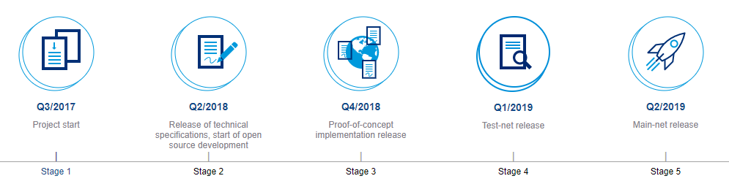
交易所联盟路线图

Slide 44



exchangeunion.com

